Slide 1

Week 4: JavaScript

Slide 2
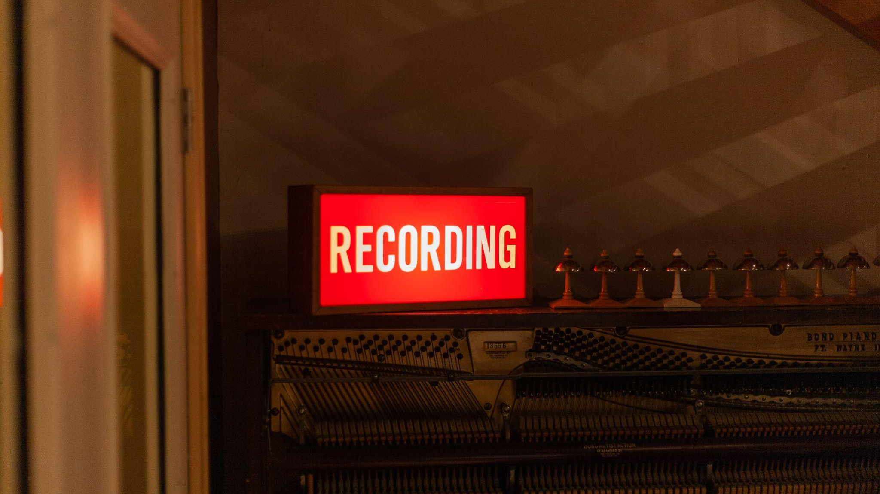

Slide 3
Live Coding: Classes
Objects Recap
Class syntax new
This keyword
Constructors
Inheritance
Getters and Setters if time

Slide 4
Classes Exercises 1: User class
Create a User class with a constructor which defines first name and last name
Create a new instance of User
Add a method to the class which return a welcome message to the given name.
Try out the method with your instance

Slide 5
Classes Exercises 2: Extends
Use the extends keyword to extend your user class by adding a property of admin which is either or true or false.
Add a method which logs a message with the status of whether the user is an admin or not
Create a new instance where the user is an admin

Slide 6
Classes Exercises 3: MDN
Have a go at the first 2 classes exercises on this website: https://developer.mozilla.org/en-US/docs/Learn/JavaScript/Objects/Test_your_skills:_Object-oriented_JavaScript

Slide 7
Live Coding: Destructoring and the Spread Operator
Spread Operator
Destructoring

Slide 8
Spread Operator Exercises 1
Create two arrays of student's names: students1 and students2. Use the spread operator to add the arrays together and console log the result.

Slide 9
Destructoring Exercises
Have a go at the first 6 destructoring exercises on this website: http://curric.rithmschool.com/springboard/exercises/js-destructuring/

Slide 10
Live Coding: Date Object
Date Object syntax
Methods: get full year, month, date, date
To local date string

Slide 11
Exercise: Date Object
Create a <p> tag showcasing “Today’s Date:” followed by an inline element displaying the date using the Date() Object
Source code for HTML should look like this, you can edit Id name if preferred:
<p>Today's Date: <span id="presentDate"></span></p>

Slide 12
Live Coding 31: JSON
JSON syntax and usage
Stringify, JSON.parse

Slide 13
Sign up!
Make sure you sign up to the open weather API and the IMDB API at least 48 hours before next weeks sessions so that you have an API key and can follow along!

Slide 14
Homework
Finish all the exercises by next week. Make sure you ask a question on Live code if you are stuck!

Slide 15


Slide 16

Questions?
JavaScript 1

